Slide 1
Module 15: Design Patterns and Sample Architectures
Notes:
Introducing Module 15: Design Patterns and Sample Architectures.

Slide 2
What’s in This Module
Part 1: High-Availability Design Patterns
Part 2: Stream Processing Example
Part 3: Sensor Network Data Ingestion and Processing Example
Part 4: Application Backend Example
Part 5: Transcoding and Serving Video Files Example
Notes:
In part 1, you will learn about design patterns for high availability.
In part 2, you will review an example of stream processing.
In part 3, you will review an example of sensor network data ingestion and processing.
In part 4, you will review an example of an application backend.
In part 5, you will review an example of transcoding and serving video files.

Slide 3
Module Objectives
Upon completing this module, you will:
Understand high-availability design patterns
Review scenarios with examples of sample architectures
Notes:
Upon completing this module, you will understand high-availability design patterns, and review various scenarios with examples of sample architectures.

Slide 4
High-Availability Design Patterns
Notes:
To begin, let’s review design patterns for high availability.

Slide 5


Multi-AZ Pattern
Pros:
If an Availability Zone fails, the system is still available as a whole.
Implementation:
Create an AMI for your instance.
Spin up multiple instances using that AMI in multiple AZs.
Create a load balancer in multiple AZs and attach the instances.
Confirm instances are attached to load balancer and are in a healthy state.
Traffic
Elastic Load Balancing
EC2
EC2
Availability Zone A
Availability Zone B
Notes:
As we begin, let’s review a multi-Availability Zone, or multi-AZ, pattern.
In this example, if an Availability Zone fails, the system is still available as a whole.
To implement a multi-AZ deployment:
• Create an Amazon Machine image—or AMI—for your instance.
• Spin up multiple instances using that AMI in multiple Availability Zones.
• Create a load balancer in multiple Availability Zones, and attach the instances.
• Finally, confirm that the instances are attached to the load balancer, and that they are in a healthy state.

Slide 6



High-Availability Database Pattern
Pros:
One connection string for master and slave with automatic failover.
Maintenance does not bring down DB but causes failover.
Read replicas take load off of master.
Implementation:
Create an Amazon RDS instance (Aurora, MariaDB, MySQL, Oracle, PostgreSQL or SQL Server).
Deploy in multiple Availability Zones.
Create read replicas for each zone (Aurora, MariaDB, MySQL, or PostgreSQL).
Amazon RDS
read replica
Amazon RDS
read replica
Amazon RDS master
Amazon RDS standby
Availability Zone A
Availability Zone B
Notes:
In this example, the pros of a high availability database pattern include:
• There is one connection string for the master and slave databases with automatic failover.
• Maintenance does not bring down the database, but it instead causes a failover.
• Finally, read replicas take the load off of the master.
To implement this pattern:
• Create an Amazon Relational Database Service—or Amazon RDS—instance by using Aurora, MariaDB, MySQL, Oracle, PostgreSQL or SQL Server.
• Deploy in multiple Availability Zones.
• Create read replicas for each Availability Zone in Aurora, MariaDB, MySQL, or PostgreSQL.

Slide 7

Floating IP Address Pattern
Problem: Your instance fails or you need to upgrade it, so you need to push traffic to another instance with the same public IP address.
Solution: Use an Elastic IP address.
Pros:
Since we are moving the Elastic IP address, DNS will not need to be updated.
Fallback is as easy as moving the Elastic IP address back to the original instance.
Elastic IP addresses can be moved across instances in different zones in the same region.
Implementation:
Allocate the Elastic IP address for the EC2 instance.
Upon failure or upgrade, launch a new EC2 instance.
Disassociate the Elastic IP address from the EC2 instance and associate it to the new EC2 instance.
Amazon Route 53
Elastic IP address
Notes:
Let’s discuss a scenario for the floating IP address pattern.
In this scenario, your instance fails, or you need to upgrade it. Thus, you need to push traffic to another instance with the same public IP address.
A solution for this situation would be to use an Elastic IP address.
• Because we are moving the Elastic IP address, the Domain Name System—or DNS—will not need to be updated.
• Fallback is as easy as moving the Elastic IP address back to the original instance.
• Elastic IP addresses can be moved across instances in different Availability Zones that are in the same Region.
To implement this pattern:
• Allocate the Elastic IP address for the Amazon EC2 instance.
• Upon failure or upgrade, launch a new Amazon EC2 instance.
• Disassociate the Elastic IP address from the Amazon EC2 instance and associate it to the new Amazon EC2 instance.

Slide 8
Floating Interface Pattern
Problem: When an instance fails or needs to be upgraded, traffic must be pushed to another instance with the same public and private IP addresses and the same network interface.
Solution: Deploy your application in VPC and use an elastic network interface (ENI) on eth1 that can be moved between instances.
Pros:
DNS will not need to be updated.
Easy rollback: move the ENI back to the original instance.
Anything pointing to the public or private IP on the instance will not need to be updated.
ENIs can be moved across instances in a subnet.
Implementation:
Allocate the ENI for the instance.
Upon failure or upgrade, launch a new instance.
Detach the ENI from the instance and attach it to the new instance.
Amazon Route 53
ENI (eth1)
Notes:
Now, let’s review a scenario for a floating interface pattern.
When an instance fails or needs to be upgraded, traffic must be pushed to another instance with the same public and private IP addresses, and the same network interface.
A solution is to deploy your application in a virtual private cloud—or VPC—and use an elastic network interface on eth1. The network interface can be moved between instances.
The advantages are that:
• The DNS will not need to be updated.
• It’s easy to roll back your changes by moving the network interface back to the original instance.
• Anything that points to the public or private IP address on the instance will not need to be updated.
• And the network interfaces can be moved across instances in a subnet.
To implement this pattern:
• Allocate the network interface for the instance.
• If you experience failure or need to upgrade, you can launch a new instance.
• Detach the network interface from the instance, and attach it to the new instance.

Slide 9

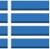
State-Sharing
Problem: You want your application to be stateless in order to better scale horizontally.
Solution: Move state off your server into a key-value store.
Pros:
This lets you use the scale-out pattern without having to worry about inheritance or loss of state information.
Implementation:
Use Amazon ElastiCache and DynamoDB for data storage.
Prepare a data store for storing the state information.
Use, as a key in the data store, an ID that identifies the user (a session ID or user ID), and store the user information as a value.
Store, reference, and update the state information in the data store, instead of storing it in the web/APP server.
ELB
Auto Scaling
State Information
Key-Value Store
Notes:
Sharing application state is an important feature to implement for an automatically scaled fleet.
In this scenario, you want your application to be stateless so that you can better scale it horizontally.
The solution for this scenario is to move the state off of your server, and into a key-value store, or KVS.
This solution lets you use the scale-out pattern without having to handle inheritance or deal with the loss of state information.
To implement this feature:
• Use Amazon ElastiCache and Amazon DynamoDB for data storage.
• Prepare a data store for storing the state information.
• When you define keys in the data store, use an identifier that identifies the user—such as a session ID or user ID—and store the user information as a value.
• Finally, store, reference, and update the state information in the data store, instead of storing it in the web or application server.

Slide 10



Scheduled Scale-Out
Problem: An application's traffic does not scale organically, but has huge jumps at specific periods of the day or for an event.
Solution: Use Scaling by Schedule or Scaling by Policy.
Advantages:
Scale in advance of a traffic spike you know will occur.
Implementation:
Create a customized AMI.
Create a Launch Config for your Auto Scaling group.
Create an Auto Scaling group for your instances (behind a load balancer).
Options:
Create Schedule Update to launch or terminate instances at a specified time.
Create Scale by Recurrence policy that will automatically scale your instances based upon cron.
Elastic Load Balancing
AMI
Notes:
In this example of a scheduled scale-out, an application's traffic does not scale organically. Instead, the application traffic has huge jumps at specific periods of the day or for an event.
A solution for this scenario would be to use Scaling by Schedule or Scaling by Policy.
Using these features allows you to scale resources in advance of a traffic spike that you know will occur.
To implement this solution:
• Create a customized AMI.
• Create a Launch Config for your Auto Scaling group.
Create an Auto Scaling group for your instances, and make sure that the Auto Scaling group is behind a load balancer.
To do this, you can:
• Create a Schedule Update to launch or terminate instances at a specified time.
• Or create a Scale by Recurrence policy that will automatically scale your instances based upon cron.

Slide 11



Job Observer Pattern
Problem: You need to manage resources against the depth of your work queue.
Solution: Create an Auto Scaling group to scale compute resources based upon queue depth.
Pros:
Compute scales with job size, providing efficiency and savings.
Job can be completed in a shorter timeframe.
Even if a work item fails to complete, process is resilient.
Implementation:
Work items for batch job placed in Amazon SQS queue as messages.
Auto Scaling group should be created to scale compute resources up or down based upon Amazon CloudWatch queue depth metric.
Batch processing servers retrieve work items from Amazon SQS to complete job.
Amazon CloudWatch
Auto Scaling
Put
Get
Notes:
In this scenario for the job observer pattern, you need to manage resources against the depth of your work queue.
The solution for this scenario is to create an Auto Scaling group that will scale your compute resources based upon your queue depth.
The advantages of this solution are that:
• Compute resources scale with the job size, which provides efficiency and savings.
• The job can be completed in a shorter timeframe.
• And even if a work item fails to complete, the process is resilient.
To implement this pattern:
• Place the batch job in the queue from Amazon Simple Queue service—or Amazon SQS—as messages.
• An Auto Scaling group should be created to scale compute resources up or down, based on the Amazon CloudWatch queue depth metric.
• Finally, batch processing servers retrieve work items from Amazon SQS to complete the job.

Slide 12


Bootstrap Instance
Problem: Code releases happen often. Creating a new AMI every time you have a release and managing these AMIs across multiple regions is difficult.
Solution: Develop a base AMI, and then bootstrap the instance during the boot process to install software, get updates, and install source code so that your AMI rarely or never changes.
Pros:
Do not need to update AMI regularly and move customized AMI between regions for each software release.
Implementation:
Identify a base AMI to start from.
Create a repository where your code is located.
Identify all packages and configs that need to occur at launch of the instance.
During launch, pass user data to your EC2 instances that will be executed to bootstrap your instance.
GitHub
AMI
Amazon S3
Notes:
Let’s review a scenario for a bootstrap instance.
Code releases happen often, so it is difficult to create a new AMI every time you have a release, and to manage these AMIs across multiple Regions.
A solution for this scenario is to develop a base AMI. You then bootstrap the instance during the boot process to install software, get updates, and install source code so that your AMI rarely or never changes.
The advantage of this solution is that you do not need to update the AMI regularly, and you also do not need to move the customized AMI between Regions for each software release.
To implement this solution:
• Identify a base AMI to start from.
• Create a repository to store your code.
• Identify all packages and configuration files that need to occur when the instance launches.
• During the launch of the instance, you can pass the user data to your Amazon EC2 instances. This data will be executed to bootstrap your instance.

Slide 13
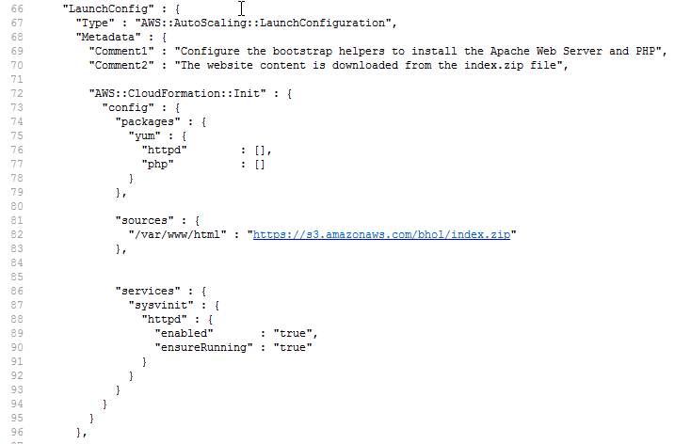
Bootstrap Instance: Example
GitHub
AMI
Amazon S3
Notes:
Displayed is an example of a bootstrap instance.

Slide 14
Stream Processing Example: The Amazon Associates program
Notes:
Next, we’ll discuss a stream processing example for the Amazon Associates program.

Slide 15

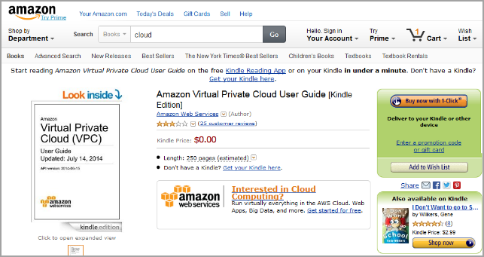
Gen 1: Amazon Associates Program
How to build this monthly payment system?
Amazon Associate earns advertising fees for qualified purchases (monthly payout)
Registered Amazon Associate adds a link to Amazon.com in their website
Payment service
Purchase was made by a user who visited Amazon.com from Associate’s link
Notes:
In this example, a registered Amazon Associate adds a link to Amazon.com in their website.
A user visits Amazon.com by using the Associate’s link and makes a purchase.
The Amazon Associate earns advertising fees for qualified purchases as a monthly payout.

Slide 16


Amazon Associates Program
Does this solution scale?
What happens as the program grows?
Payment Service
orders
C++ app
Out Of Memory
C++ app
C++ app
Pulls data from the database every 2 hours
generates
generates
Associate | Total
Alice | 25
Bob | 49
Charlie | 63
David | 29
bi-hourly
flat files
daily
aggregations
Notes:
With the Amazon Associates program, you add a link to Amazon.com on your website, and if people use the link and buy something, Amazon will give you a share of that sale, up to 15%.
How much to pay each associate every month is an extremely important problem. It is critical that Amazon is correct, but still it seems like a fairly straightforward problem. Amazon tracks every sale that is attributed to an associate link, adds up the sales at the end of the month, and pays the associate at the appropriate rate. The reality is a little more complicated, though, because Amazon must track an order throughout its lifecycle to know whether the order was cancelled or returned.
This slide illustrates the system that Amazon built over 12 years ago. A single-threaded C++ application connected directly to the production orders database every two hours, and exported the orders that it was interested in into a series of flat files. Next, another C++ application ran once a day to aggregate the bi-hourly files into a daily view.
Finally, another system ran once a month to scan over the daily aggregates, calculate how much to pay people, and give that information to the payments service, which was run by a totally separate team.
This system ran very smoothly until about 2008, when the scale of the associates program grew to the point where the daily aggregations system started to run out of memory. The program needed a way to process large volumes of data quickly.
Select the link to learn more about the Amazon Associate’s Program.
https://affiliate-program.amazon.com/gp/associates/join/landing/main.html

Slide 17

Amazon EMR
Amazon EMR is managed platform that simplifies running big data frameworks, such as Apache Hadoop and Apache Spark, on AWS Cloud.
What is Hadoop?
An open source project written in Java, managed by the Apache Software Foundation.
Built for:
Handling uncertainty
Handling high data variety, volume, and velocity.
Providing solution flexibility: Write your own data applications.
Processing large batches of data (such as logs).
Notes:
To solve the problem Amazon Elastic MapReduce, or EMR, was created. Amazon EMR is a managed cluster platform that simplifies running big data frameworks, such as Apache Hadoop and Apache Spark, on the AWS Cloud so that users can process and analyze large amounts of data.
Hadoop is an open source project written in Java, and is managed by the Apache Software Foundation.
It uses a distributed processing architecture called Amazon EMR in which a task is mapped to a cluster of commodity servers for processing. Each piece of work that is distributed to the cluster servers can be run or re-run on any of the servers.
The cluster servers use Hadoop Distributed File System—or HDFS—to store data locally for processing. The results of the computation that is performed by those servers are then reduced to a single output set. One node, which is designated as the master node, controls the distribution of tasks. The master node can automatically handle server failures.
Hadoop provides a number of benefits:
First, Hadoop handles uncertainty by facilitating data navigation, discovery, and ad-hoc data analysis. Hadoop allows you to compensate for unexpected occurrences by allowing you to analyze large amounts of data quickly in order to form a response.
Hadoop also handles high data variety, volume, and velocity. Unlike traditional database systems, Hadoop can process structured, unstructured, or semi-structured data. This includes virtually any data format that is currently available, such as Extensible Markup Language, or XML; comma-separated values, or CSV, files; text; log files; objects; SQL; JavaScript Object Notation, or JSON; and binary formats. In addition to natively handling many types of data, Hadoop can transform data into formats that allows for better integration into your existing data sets. Also, you can store data with or without a schema, and you can perform large-scale extract, transform, load—or ETL—processes to transform your data.
Hadoop provides flexibility so you can write your own data applications. Because Hadoop is open source, there are a number of ecosystem projects that can help you analyze the multiple types of data that Hadoop can process and analyze. These projects allow you tremendous flexibility when you develop big data solutions. Hadoop’s programming frameworks—including Hive, Pig, and so on—can support almost any big data use case for your applications.
Hadoop can process large batches of data, such as logs. Because of Hadoop’s distributed architecture, Hadoop clusters can affordably handle tremendous amounts of data. Adding additional data processing capability is as straightforward as adding additional servers to your cluster for linear scaling.

Slide 18
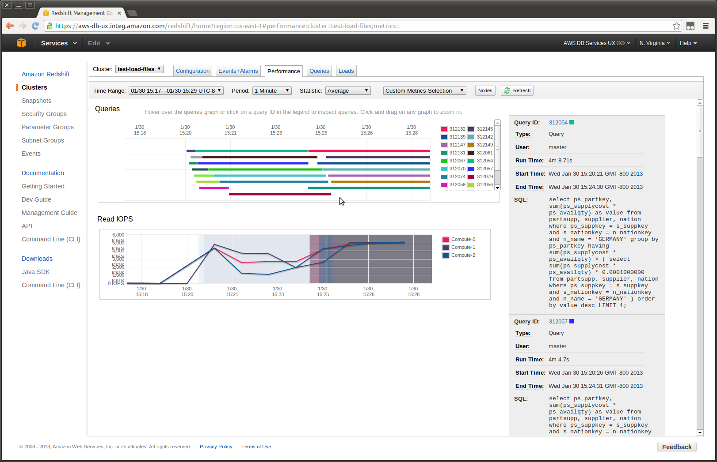

Amazon Redshift
Amazon Redshift is a fully managed, petabyte-scale data warehouse service.
Provision in minutes.
Monitor query performance.
Point and click resize.
Built-in security.
Automatic backups.
Notes:
You can build business intelligence with Amazon Redshift. Amazon Redshift is a fully managed, petabyte-scale data warehouse service.
With Amazon Redshift, you can:
• Provision a resource in minutes
• Monitor the performance of your query
• Resize via point and click
• Use built-in security
• And configure automatic backups

Slide 19





Gen 2: EMR for Amazon Associates
$
Send a check to associates
Order data
Get reports
Payment Service
OLAP server/
JDBC
Amazon Redshift
Bi-hourly flat file
Daily aggregates
Amazon EMR Cluster
Monthly totals
Business Intelligence
Daily aggregates
Amazon S3 bucket
Amazon EMR Cluster
Notes:
To implement Amazon EMR as a solution for the Amazon Associates program’s architecture, the team developed a system that publishes the raw orders stream to a set of registered listeners. The Amazon Associates team wrote an application that listens to the orders stream, filters it, retrieves any additional data it might need about the order from other services, and places it into Amazon Simple Storage Service, or Amazon S3. Then, a Hadoop cluster starts on a daily basis, and it pulls 60 days of order history out of Amazon S3. It adds the month-to-date sales of every associate, computes pay rates, and stores all of that data back on to Amazon S3. After the architecture adopted a distributed solution, larger and larger data sizes no longer posed a problem. As the volume of data grew, the Amazon Associates team did not have to struggle to figure out how to fit the data in memory on a single machine. All the team needed to do was to add machines to their cluster. The code that runs in the cluster doesn’t change at all.
To solve all these issues, Amazon moved to Amazon EMR, which can be considered to be like running Hadoop in the cloud.
There are significant advantages to Amazon EMR:
• Cluster setup and resizing takes minutes.
• You can create application-specific cluster configurations.
• A container-managed service makes software installation and upgrades trivial.
• And the cost is usually much lower.
The total cost of an on-premises deployment in comparison to Amazon EMR includes:
• The time and expense spent in sizing and ordering hardware.
• The development effort.
• And the cost of maintaining the system and administrative personnel.

Slide 20
What’s Next?
Generation 2 solution achieved the following:
Replaced the file system with Amazon S3.
Used Amazon EMR to remove the performance bottleneck that was caused by the single-threaded C++ application.
Added analytics and data insight with Amazon Redshift.
How can we further improve this system as the load increases?
Real-time data processing.
Notes:
So, what’s next?
The second generation of the Amazon Associates program achieved the following changes:
• The file system was replaced with Amazon S3.
• Amazon EMR was used to remove the performance bottleneck that the single-threaded C++ application caused.
• And features for analytics and data insight with Amazon Redshift were added.
How can this system be further improved while the load increases? One improvement is adding real-time data processing.

Slide 21

Batch Versus Streaming
Batch processing (“cold” data)
Stream processing (“hot” data)
Hourly server logs
System issues from an hour ago
Weekly, monthly bill
Spending in past billing cycle
Daily customer preference report from clickstream logs
Daily fraud reports
Was there fraud yesterday?
Compiling Amazon CloudWatch metrics
Monitor issues immediately
Real-time spending alerts, caps
Respond to sudden cost increases
Real-time analysis
What to offer the customer now
Real-time detection
Block fraudulent use now
Notes:
Batch processing typically involves querying large amounts of “cold” data. In batch processing, you can retrieve hourly server logs that display system issues from several hours ago. You receive a weekly or monthly bill that shows your spending across the past billing cycle. A daily customer preference report is available from clickstream logs, and daily fraud reports to tell you whether you experienced any fraud yesterday.
Stream processing is in real time, and it typically involves querying small amounts of “hot” data. It takes only a short amount of time to get answers.
Stream processing compiles Amazon CloudWatch metrics immediately, and it also monitors issues. You have access to real-time spending alerts and caps. You can also respond to sudden cost increases. You receive real-time analysis, and you can make customer offers immediately. Real-time fraud detection also allows you to immediately block fraudulent use.

Slide 22




Amazon Kinesis
Collect, process, and analyze video and data streams in real time.
Capture, process, and store video streams for analytics and machine learning.
Build custom applications that analyze data streams using popular stream processing frameworks.
Amazon Kinesis
Video Streams
Amazon Kinesis
Data Streams
Load data streams into AWS data stores.
Analyze data streams with SQL.
Amazon Kinesis
Data Firehose
Amazon Kinesis Data Analytics
Notes:
With Amazon Kinesis, you can collect, process, and analyze video and data streams in real-time. You can get timely insights and react quickly to new information. Amazon Kinesis offers key capabilities to cost-effectively process streaming data at any scale, and it offers you the flexibility to choose the tools that best suit the requirements of your application.
Amazon Kinesis Video Streams is a fully managed AWS service that you can use to capture, process, and store video streams for analytics and machine learning.
You can use Amazon Kinesis Data Streams to collect and process large streams of data records in real time. With Amazon Kinesis Data Streams, you can build custom applications that analyze data streams by using popular stream-processing frameworks.
Amazon Kinesis Data Firehose is a fully managed service for loading data streams into AWS data stores. Amazon Kinesis Data Firehouse delivers real-time streaming data to destinations such as Amazon S3; Amazon Redshift; Amazon Elasticsearch Service, or Amazon ES; and Splunk.
With Amazon Kinesis Data Analytics, you can process and analyze streaming data by using standard SQL. The service enables you to quickly author and run powerful SQL code against streaming sources to perform time series analytics, feed real-time dashboards, and create real-time metrics.

Slide 23




Amazon Kinesis Data Streams
Near-real-time performance | High throughput, elastic
Perform continual processing on streaming big data. Processing latencies fall to a few seconds, compared with the minutes or hours associated with batch processing. | Seamlessly scale to match your data throughput rate and volume. Easily scale up to gigabytes per second. It can scale in or out based on operational or business needs.
Build near real-time apps | Low cost
Client libraries enable developers to design and operate near real-time streaming data processing applications. | Cost-efficient for workloads of any scale. Get started by provisioning a small stream, and pay low hourly rates only for what you use.
Notes:
Let’s review the key benefits of Amazon Kinesis Data Streams.
Amazon Kinesis Streams offers near-real-time performance, which allows you to perform continual processing on streaming big data. The processing latencies are reduced to a few seconds, compared with the minutes or hours that are associated with batch processing.
Client libraries enable developers to design, build, and operate applications that use near-real-time streaming data processing.
Amazon Kinesis Streams has high throughput that is also elastic. You can seamlessly scale to match the throughput rate and volume of your data. You can scale up to gigabytes per second. Amazon Kinesis Streams can scale in or out based on your operational or business needs.
Amazon Kinesis Streams is also cost-efficient for workloads of any scale. You can get started by provisioning a small stream, and pay low hourly rates only for what you use.

Slide 24




Twitter Trend Analysis Application
tweets
Twitter trend analysis application
Global top 10 Twitter trends
tweets
Elastic Beanstalk
tweets
Too big to handle on one box
Notes:
Let’s view an example of an application for Twitter trend analysis. The planned functionality for the twitter-trends.com website is to display the top 10 current trends on Twitter. On AWS, you might begin by creating a basic AWS Elastic Beanstalk website.
Unfortunately, the Twitter firehose feed is quickly becoming too big to process on a single machine. You will need to divide up the work so that it can be done in parallel on multiple machines. The workload must then be combined into an output that can be vended by the Elastic Beanstalk web server.
In this case, you could compute a local top-10 value for all the tweets coming into each processing instance, and then combine all top-10 lists into a global top-10 list in the web server. The problem is that, without some sorting or grouping function, each processing instance will receive a random selection of tweets. This situation makes it impossible for any one instance to know how many tweets are occurring for any specific topic.

Slide 25

MapReduce Technique
Stream
Partition key
tweets
tweets
Twitter trend analysis application
Kinesis app
My top 10
Global top 10
tweets
tweets
Amazon Kinesis
My top 10
Kinesis app
Shard
Elastic Beanstalk
My top 10
tweets
Kinesis app
Worker
Notes:
You can solve this problem by applying a technique from the MapReduce world. If you are computing the top 10 tweeted topics for a standalone batch of tweets, you can treat the topic of each tweet as a partition key (for example, #WorldCup). Each map task would take in a fraction of all tweets, group them by topic, and send the count for each topic to the appropriate reduce task that is responsible for that topic.
You can do something equivalent by introducing an intermediate stage that takes in the stream of tweets and orders them by topic. Each processing box would then pull only the tweets for the set of topics that it is responsible for. This would enable each box to be an authoritative counter of tweets for some subset of all currently active tweet topics. This process is essentially the streaming equivalent of the MapReduce processing paradigm.

Slide 26






Real-Time Order Processing
Update earning information for the associate
Order data
Payment Service
Amazon Kinesis Streams
Order Process
Lambda function
Amazon DynamoDB
Reports
Amazon S3
Amazon Kinesis Analytics
Amazon Redshift
Amazon Kinesis Firehose
Business Intelligence
Amazon EMR Cluster
Notes:
In this example:
• Every order that Amazon.com receives is pushed to Amazon Kinesis.
• If the order is linked to an Associate program—that is, it’s a qualified order—that order information is stored in an Amazon S3 bucket. Because the qualified order is mapped to a specific Amazon associate, the information can be stored in Amazon DynamoDB. The associate can log into a web application to see how many people came to their website and purchased a product at Amazon.com.
• The Amazon EMR cluster retrieves the qualified order information from the Amazon S3 bucket, and then the monthly total is stored in Amazon Redshift. A business intelligence application can then run some analysis on the information.
• A payment service then pulls the report, and sends payment checks to the associates every month.

Slide 27
Sensor Network Data Ingestion and Processing Example: Flu Outbreak Heat Map
Notes:
Now, we will discuss an example of sensor network data ingestion and processing that is focused on an outbreak heat map for influenza, or the flu.

Slide 28
Example: Flu Data
Scenario: Influenza outbreak around the world
Office
Mission:
Based on the data you collect, generate heat maps to understand public health
Office
Office
Office
Office
Office
Notes:
In this scenario, the Government Health Organization wants to understand a flu outbreak that is happening around the world. Their mission is to understand the state of public health by collecting data, and using the data to generate heat maps.

Slide 29

Generation 1: Flu Heat Map
Office 1
Does this scale?
Is there a concern for a single point of failure?
What AWS services would you use?
Office 2
Applications to aggregate data
Office 3
FTP server
…
Office N
Notes:
This scenario is based on a real-world example. It is not rare to see a government organization that uses very basic technology. In this case, all of the federal offices send the flu data to a central file transfer protocol—or FTP—server.
This solution does not scale, and the FTP server can become a single point of failure. Because of the nature of file systems, this solution does not generate a near-real-time heat map for flu cases.
Could you use Amazon Kinesis? The issue with Amazon Kinesis is that its payload size is limited. The data that comes from global offices probably exceeds the allowed payload size for Amazon Kinesis.

Slide 30


Generation 2: Flu Heat Map
Web identity provider
SAML 2.0
What are your concerns with this?
Government Office
PUT
Credential
Office 1
Session data
Edge Location A
Heat map
EC2
Office 2
Amazon CloudFront
Amazon S3
Generate heat map
…
Amazon Redshift
SSL/TLS
Edge Location B
Region
Office N
Notes:
What are your concerns with this example?
One concern is that Amazon CloudFront is compatible with this use case, but it does not cache the following operations:
• POST
• PUT
• PATCH
• DELETE
• Or OPTIONS

Slide 31

Generation 3: Flu Heat Map
Government Office
Web identity provider
SAML 2.0
XML
Credential
SSL/TLS
Office 1
Session data
Office 2
Business Intelligence
SSL/TLS
Kinesis
Data
Streams
Kinesis-enabled app
Amazon Redshift
…
Office N
Notes:
In this case, the payload on each report is not very large. Kinesis provides the speed that you want for processing the data.

Slide 32
Application Backend Example: Mobile Gaming
Notes:
Now, let’s review an example of an application backend for mobile gaming.

Slide 33


Mobile Games
Mobile app revenue is projected to grow continuously.
Mobile back-end technologies
HTTP-based
External Social APIs
Save state
Database
Static data store
Mobile push
Analytics
Notes:
Mobile app revenue is projected to grow continuously.
Mobile backend technologies include:
• HTTP-based technologies
• External social application programming interfaces, or APIs
• Save state
• Databases
• Static data stores
• Mobile push
• And analytics
A few mobile gaming customers that use AWS include:
• Supercell, which offers Hay Day and Clash of Clans
• Halfbrick, which offers Fruit Ninja
• Wooga, which offers Diamond Dash and Pocket Village
• Ubisoft, which used AWS to launch 10 social games in 18 months
• SEGA, which migrated forums and some game servers to AWS and reported a 50% savings in server costs
• FunPlus Game, a successful Facebook game company that began without physical servers but quickly moved to AWS to gain agility and reduce costs

Slide 34






Mobile Games Backend Concepts
Amazon CloudFront
Think in terms of APIs
GET friends, leaderboards
HTTP + JSON
Multiplayer servers
Binary assets
Game analytics
Elastic Load Balancing
EC2
EC2
Amazon S3
Elastic Beanstalk Container
Notes:
Mobile game backends are becoming more and more like the backends of web applications. For example, gaming backends use:
• APIs to provide data and functionality
• GET requests to retrieve data about friends and leaderboards
• Hypertext Transfer Protocol—or HTTP—and JSON
• Multiplayer servers
• Binary assets
• And game analytics

Slide 35

Improve Your Game
Sentiment analysis
Enjoying game
Engaged
Like or dislike new content
Stuck on a level
Bored
Abandonment
Players’ behavior
Hours played day or week
Number of sessions per day
Level progression
Friend invites or referrals
Response to mobile push
Money spent per week
Notes:
What information can help improve your game?
Let’s review some examples of how to use data analysis to gain insights from sentiment analysis and player behavior.
To get insight into how your application is perceived, it can be helpful to collect data about the behaviors of your users. This means ingesting and processing streams of data as your application is being used, and then performing analysis on that data to gain insights from it.
For example, you might want to know if users are enjoying the game, if they are engaged, and whether they like or dislike new content. Understand why they’re stuck on a level, bored and have abandoned the game.
You can analyze players’ behavior to include hours played per day or week, the number of sessions per day, their level progression, and whether they invite or refer friends. You could also analyze the response to mobile push, and how much money your users spend per week.

Slide 36

Data Analytics for Gaming
Batch processing examples:
What game modes do people like best?
How many people have downloaded?
Where do most player characters die?
How many daily players are there on average?
Real-time processing examples:
What game modes are people playing now?
Are more or fewer people downloading today?
Are player characters dying in the same places, or different places?
How many people are playing today? Is there any variance?
Notes:
Downloadable content is additional content for a video game that is distributed through the internet by the game’s official publisher or other third-party content producers. It can be of several types, ranging from aesthetic outfit changes to a new, extensive storyline that is similar to an expansion pack.
Some examples of batch processing include:
• What game modes do people like best?
• How many items people have downloaded?
• Where do most player characters die?
• How many daily players are there on average?
Examples of real-time processing include:
• What game modes are people playing now?
• Are more or fewer people downloading content today?
• Are player characters dying in the same places, or different places?
• How many people are playing today? Is there any variance in the number of players?
Both types of analysis are valuable, but when you can quickly determine what your players love, you can make your game have more of the things that your players want.

Slide 37
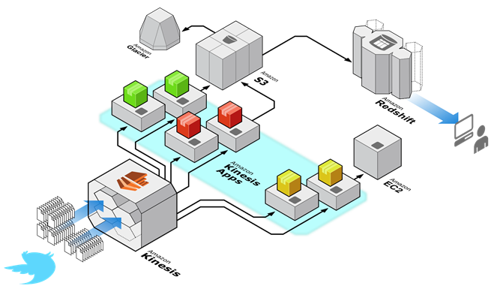
Data Analytics for Gaming
Clickstream archive
Aggregate statistics
In-game engagement trend analysis
Clickstream processing application
Clicks
Notes:
This example shows a reference architecture. Let’s review some use cases for data analytics in gaming.
Use cases for data analytics in gaming include:
• Tracking player performance to keep games balanced and fair.
• Tracking game performance metrics by geography or region for online games that have a global player base.
• Tracking sales performance of items sold in-game.
• Tracking performance of online advertisements served in-game.
• Accelerating the delivery of the metrics that are described above to near-real-time.
• Retrieving continual in-game metrics on user engagement.
• Accessing real-time analytics on user engagement in the game.
• Receiving optimized predictions of when or where to sell in-game purchases.
The business benefits for using data analytics in gaming include:
• Reducing the operational burden on your developers.
• Scaling your data analytics to match highly variable gaming loads without overpaying for spare capacity or experiencing increased time-to-results when usage is up.
• Trying more experiments with data experiments, and finding new and game-changing metrics and analysis.
• Ingesting and aggregating gaming logs that were previously uncollected or unused.
• Accelerating the time-to-results when you batch process game logs so that you can reduce the delivery of gaming metrics from every 48 hours to every 10 minutes.
• Deliver continuous or real-time game insight data from hundreds of game servers.

Slide 38





Case Study: Supercell
Analytics pipeline for Clash of Clans
Amazon EC2: Real-time Kinesis apps
Amazon S3: Aggregate statistics
Amazon Redshift
In-game
activity
Amazon Kinesis
EC2: In-game trends dashboard
Notes:
Supercell is a gaming company that is based in Finland, and it was founded in 2010 by six game-industry veterans. It is one of the fastest-growing social game developers in the world. With a staff of just over 100 employees, Supercell has three games:-Hay Day, which is a social farming game; Clash of Clans, which is a social resource management game with strategic combat; and Boom Beach, which is a combat strategy game. These games attract tens of millions of players on iOS and Android devices every day.
As an example, let’s discuss Clash of Clans. Data is loaded into Amazon Redshift for business intelligence tasks, and the data is also moved into Amazon S3 for long-term archiving. The team can restore the vaults from Amazon Glacier if they need to perform tasks such as recovering data, loading retrospective information into a new data warehouse instance, or augmenting their reports with data that was not originally available.
SuperCell uses Amazon Kinesis with Amazon EC2, Amazon S3, Amazon Glacier, and Amazon Redshift to gain a complete view of how their customers are playing their games. These AWS services also provide resources for analytics. The team can dive into player data to answer specific questions, such as who are the high scorers, which areas of the game world are most popular, or how their most recent updates are performing.
Sami Yliharju, who is the Services Lead at Supercell, states: “We are using Amazon Kinesis for real-time delivery of game insight data sent by hundreds of our game engine servers. Amazon Kinesis also offloads a lot of developer burden in building a real-time, streaming data ingestion platform, and enables Supercell to focus on delivering games that delight players worldwide.”
You can learn more about Supercell by selecting the link.
http://aws.amazon.com/solutions/case-studies/supercell/

Slide 39
Example: Transcoding and Serving Video Files
Notes:
Finally, let’s discuss an example for transcoding and serving video files.

Slide 40
Transcoding Video Files
Challenging to set up:
Difficult to choose the right transcoding settings.
Complicated to build a system that performs well.
Difficult to adapt:
Amount of content can scale up quickly.
Output formats and device types change frequently.
Complex cost issues:
Building for peak is uneconomical.
Storage and delivery costs on a large scale can be prohibitive.
Notes:
Transcoding video files can be a challenging process to set up. It’s difficult to choose the right transcoding settings, and it is complicated to build a system that performs well.
The transcoding process can be difficult to adapt, so the amount of content can scale up quickly as output formats and device types change frequently.
Complex cost issues include building for the peak, which is not economical. In addition, storage and delivery costs on a large scale can be prohibitive.
It can be difficult to adapt, so the amount of content can scale up quickly as output formats and device types change frequently.
Complex cost issues including building for the peak, which is uneconomical and storage and delivery costs on a large scale can be prohibitive.

Slide 41

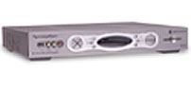






Amazon Elastic Transcoder
Digital Media Source Asset
Digital Media Destination Asset
Amazon Elastic Transcoder
Amazon S3 Input Bucket
Amazon S3 Output Bucket
Notes:
Amazon Elastic Transcoder is a highly scalable and cost-effective way for developers and businesses to convert—(or “transcode”—video files from their source format into versions that will play on devices like smartphones, tablets, and personal computers. You can use Elastic Transcoder to convert files from different media formats into H.264, VP9, VP8, AAC, MP4, and MPEG-DASH files at different resolutions, bitrates, and frame rates. You can also set up transcoding pipelines to transcode files in parallel.
Any customer with media assets that are stored in Amazon S3 can use Elastic Transcoder. Examples include developers who create applications or websites that publish user-generated content, enterprises and educational establishments that convert training and communication videos, and content owners and broadcasters that need to convert media assets into web-friendly formats.

Slide 42

Review
Reviewed High-Availability Design Patterns
Reviewed scenarios with examples
To finish this module:
Complete:
Knowledge Assessment
Notes:
In review, you now understand design patterns for high availability and have reviewed various scenarios with examples of sample architectures. To finish this module, complete the corresponding knowledge assessment.
42

Slide 43
Thanks for participating!
© 2018 Amazon Web Services, Inc. or its affiliates. All rights reserved. This work may not be reproduced or redistributed, in whole or in part, without prior written permission from Amazon Web Services, Inc. Commercial copying, lending, or selling is prohibited. Corrections or feedback on the course, please email us at: aws-course-feedback@amazon.com. For all other questions, contact us at: https://aws.amazon.com/contact-us/aws-training/. All trademarks are the property of their owners.
Notes:
Thanks for participating!

